Slide 1

Choosing a Variety of Foods for Good Health
Presentations for PowerPoint
Kali9/iStock/Getty Images

Slide 2
Choosing a Variety of Foods
What does it mean to eat a variety of foods?
The human body needs more than 40 different nutrients to stay healthy and grow normally.
Good nutrition has many benefits to the body. Can you name one?
No one food has all the nutrients a child, teen, or adult needs. When you eat many different foods, you receive different nutrients from each one.

Slide 3
Learning Outcomes
Describe the food groups and the foods they contain.
Compare portions from each food group.
Define a healthy eating pattern.
Discuss tools for planning a healthy eating pattern.
Explain how the Dietary Guidelines for Americans are used.
Describe food and beverage choices you could make to improve your dietary pattern.

Slide 4
Understanding the Food Groups
Foods are organized into food groups based on:
  The type of food, such as a plant or an animal
  The type of micronutrients (vitamins, minerals)
  The type of macronutrients (protein, carbohydrate, fat)
The best way to give your body a variety of nutrients needed for health is to choose different foods from all the food groups–grains, vegetables, fruits, protein foods, dairy, and fats.

Slide 5
Choosing Nutrient-Dense Foods
Eating nutrient-dense foods promotes good health.
Nutrient-dense foods provide higher amounts of vitamins, minerals, and other health-promoting components along with calories (energy).
These foods typically have fewer saturated fats, added sugars, and sodium.
Fruits, vegetables, low-fat milk, lean meat, and whole grains are examples of nutrient-dense foods.

Slide 6
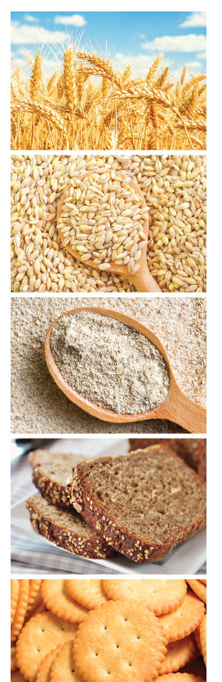
Grains Group
Some common grains are wheat, rice, barley,
oats, rye, and cornmeal.
Grains often undergo food processing to create
another food product.
Grains are used to make breads such as rye bread,
sourdough bread, corn bread, tortillas, biscuits,
and bagels.
Grains also are used to make ready-to-eat breakfast
cereals, noodles, and pasta.
Ievgenii Meyer/Shutterstock.com; Gayvoronskaya_Yana/Shutterstock.com; Jiri Hera/Shutterstock.com; mama_mia/ Shutterstock.com; Bohbeh/Shutterstock.com

Slide 7
What Is a Processed Food?
Fresh or processed?
  Processed foods are foods that have undergone some preparation procedure such as canning, freezing, drying, cooking, or fortification
Degrees of processing
  Whole foods—no added ingredients
  Minimally processed—changed to help preservation
  Moderately processed—contain added sugars, fats, or sodium
  Highly-processed or Ultra-processed foods—may include extensive processing, include certain preservatives, or additives, but there is no strict definition of what is considered an ultra-processed food

Slide 8
Whole Grains (1 of 2)
When you eat a grain that has not been highly processed, it is called a whole grain.
Whole grains contain the entire grain kernel and are a good source of fiber. This carbohydrate does not provide calories (energy) but has many important functions.
Inside the kernel is the germ and the endosperm.
  The germ provides vitamins and minerals.
  The endosperm provides starch, a good form of energy.
  The outer kernel, called the bran, is where the fiber is found.

Slide 9
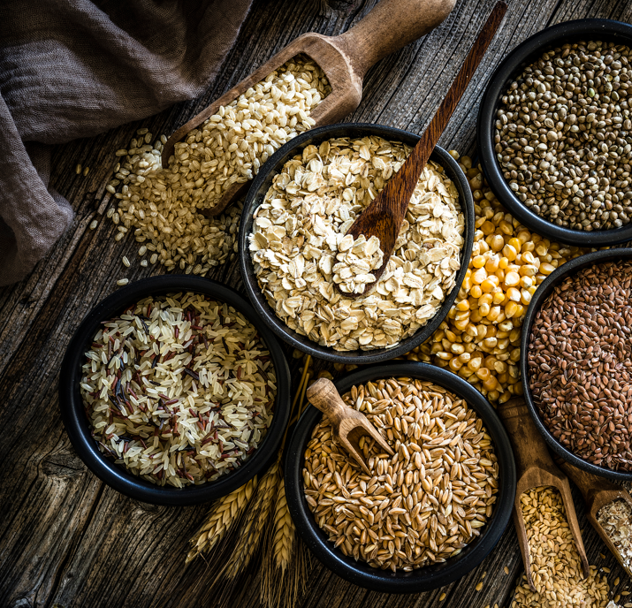
Whole Grains (2 of 2)
Whole-wheat bread and pasta, oatmeal, popcorn, and brown rice are examples of whole grains. Foods made from whole grains have the greatest variety of nutrients and more fiber than other foods in this group.
  Fiber helps you feel full.
  It moves waste through your digestive systems to prevent constipation.
  Fiber keeps the bacteria that naturally live in your intestines healthy.
  A diet high in fiber may lower the risk of developing heart disease and certain types of cancer, too.
Fcafotodigital/Getty Images

Slide 10
Refined Grains and Enriched Grains
Most of the grains that Americans eat have been processed more extensively. When grains are refined, the bran and germ are removed along with important vitamins and minerals.
Food manufacturers are required to enrich these refined grains like crackers, bread, pasta, and cereal with B vitamins and iron that have been lost in processing.
Because most people don’t eat enough vegetables and fruits, folic acid is also fortified in refined grains so that people do not have a folate deficiency.
Although most refined grains have these vitamins and iron added back, dietary fiber is not added back.
To know if a refined grain has had the vitamins and iron added back, look for those labeled enriched.

Slide 11
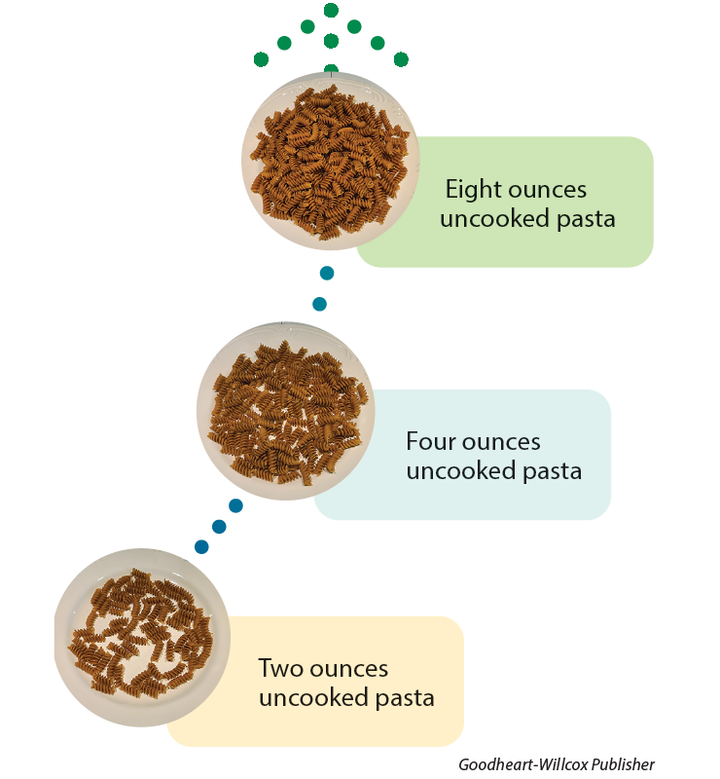
Serving Size Versus Portion Size
Portion size is the amount of a food or beverage served or consumed during one eating occasion.
Serving size is a set amount identified on the Nutrition Facts label or listed in a food group to compare different nutrient values in foods.
Goodheart-Willcox Publisher

Slide 12
Grain Group Servings
1 ounce-equivalent serving:
1 slice bread
1 cup (250 mL) dry cereal
½ cup (125 mL) cooked cereal, rice, or pasta
Whole grains: brown rice, bulgur, oatmeal, popcorn, whole grain barley and corn, whole grain cereals and crackers, whole wheat breads, wild rice
Refined grains: enriched cereals, crackers, and pasta; flour and tortillas; white breads; white rice

Slide 13

Grains as a Source of Added Sugars
Foods in the grain group have different amounts of added sugars and added fats.
Whole grains are naturally low in sugars.
Cakes, cookies, muffins, pastries, and many other desserts are made from grains, too. These foods have more calories, fat, and sugar, but less fiber, vitamins, and minerals than other foods in this group.
Other refined grains include snack foods like cheese puffs, pretzels, or crackers, and entrees like pizza or noodles, which are often high in sodium.
Binh Thanh Bui/Shutterstock.com

Slide 14
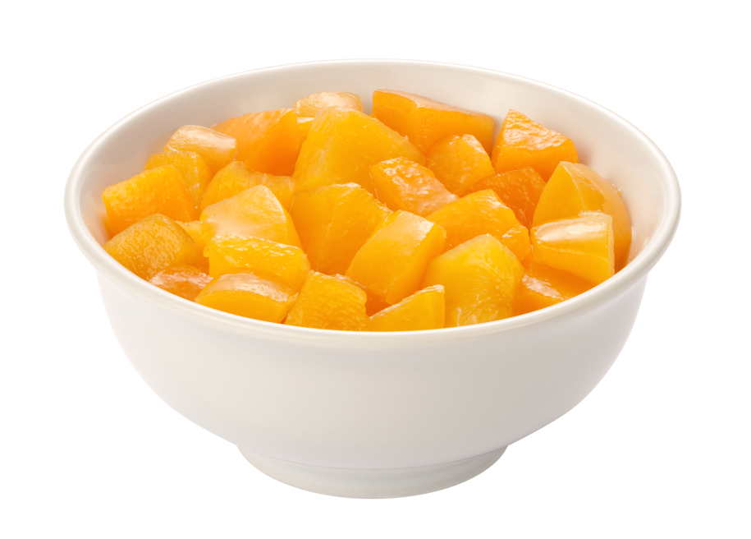
Fruit Group
Fresh, frozen, canned, and dried fruits are all included in this group. 100% fruit juice, without added sugars, is also included.
Fruits are nutrient-dense foods. Fruits are good sources of carbohydrates, fiber, vitamins, and minerals. Except for avocados, fruits are not a source of fat. Fruits are an excellent way to meet your needs for vitamin C, folate (a B vitamin), and potassium.
Rimglow/iStock/Getty Images Plus

Slide 15
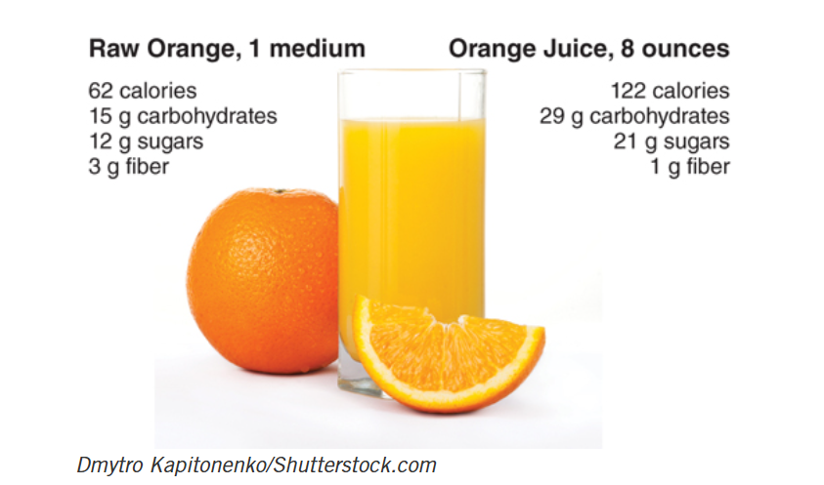
Whole Fruit versus Juice
Fruits taste sweet because they contain naturally occurring sugar, but they also have vitamins and minerals needed for good health. This makes them a more nutrient-dense food and a good choice for the body.
Dmytro Kapitonenko/Shutterstock.com

Slide 16
Fruit Group Servings
What counts as a serving?
1 cup (250 mL) fresh or canned fruit
1 cup (250 mL) fruit juice
½ cup (125 mL) dried fruit
Fruits such as:
Apples, apricots, bananas, blueberries, cantaloupe, cherries, figs, fruit juice, grapefruit, grapes, kiwifruit, mangoes, oranges, papayas, peaches, pineapple, plums, raisins, strawberries, watermelon

Slide 17
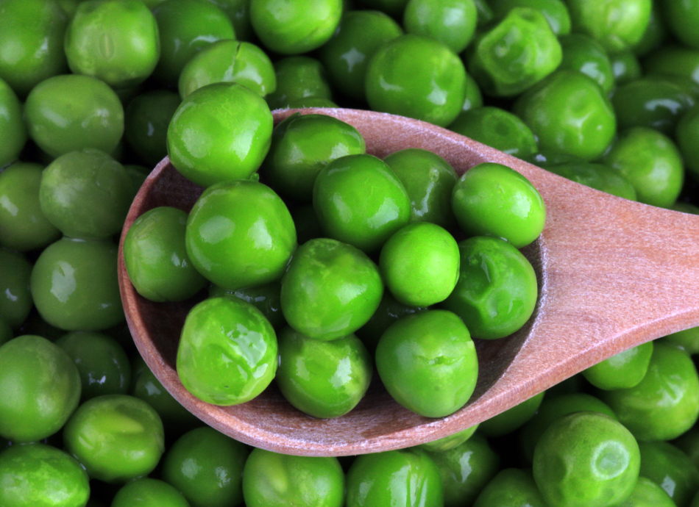
Vegetable Group
Includes any vegetable or vegetable juice
  Raw, cooked, canned, frozen, or dried
Good sources of dietary fiber, vitamins, and minerals
  Most Americans do not get enough potassium, a mineral important for heart function and muscle contraction which is found in vegetables
Many health conditions would be improved by eating more plants
Do you prefer your vegetables raw or cooked?
mares/Shutterstock.com

Slide 18
Include a Variety of Vegetables
Including a variety of different vegetables has many benefits for health.
Vegetables can be categorized by the type of plant and the common nutrients provided by the similar plants:
  Dark green—broccoli, spinach, collard greens, kale
  Red and orange—carrots, winter squash, sweet potatoes
  Beans, peas, lentils—split and black-eyed peas, red lentils, navy beans
  Starchy vegetables—white potatoes, corn
  Other vegetables—cauliflower, lettuce, green beans, onions
Including some from each group in your meals provides different tastes and health benefits.

Slide 19
Vegetable Group Servings
Dark green vegetables: broccoli; collard, turnip, and mustard greens; romaine; spinach
Red and orange vegetables: carrots, pumpkin, sweet potatoes, winter squash, tomatoes, red peppers, beets
Beans, peas, and lentils: kidney, lima, and navy beans; black-eyed peas; chickpeas; lentils
Starchy vegetables: corn, green peas, white potatoes
Other vegetables: bok choy, cucumbers, eggplant, green beans, lettuce, okra, onions, pea pods, green bell peppers, summer squash
1 cup-equivalent serving:
1 cup (250 mL) fresh or cooked cut vegetables
1 cup (250 mL) vegetable juice
2 cups (500 mL) raw leafy vegetables

Slide 20
Protein Foods Group
Protein foods are sources of essential amino acids, vitamins E and B, and minerals.
  Meat, poultry, seafood, beans, peas, lentils, eggs, nuts, seeds
Choosing lean meats and poultry over processed meats can reduce saturated fat and sodium.
  Processed protein foods include breaded nuggets, lunch meats, plant-based meat alternatives, protein powders
Choosing unsalted nuts and seeds supplies beneficial oils while limiting sodium.

Slide 21
Protein Foods Group Servings
A 1 ounce-equivalent is used as a portion to provide equal amounts of protein (7 grams) per ounce:
1 ounce (28 g) cooked lean meat, poultry, or seafood
1 egg
1 tablespoon (15 mL) peanut butter
¼ cup (60 mL) cooked dry beans or tofu
½ ounce (14 g) nuts or seeds
Foods such as: beef, beans, peas, chicken, eggs, fish, lamb, lentils, nuts, peanut butter, pork, rabbit, seeds, shellfish, tofu, turkey, veal, venison
In the 2025–2030 Dietary Guidelines, the portion for meat, poultry, and seafood has been increased to 3 ounces as one serving, but the other portions remain as listed.

Slide 22
Dairy Group
Dairy foods are good sources of calcium as well as riboflavin, phosphorus, and protein.
  Fortified milk provides vitamins A and D
  Can be purchased in different levels of fat
  Butter, cream, and cream cheese are not considered dairy equivalents
  (equal to milk) because they contain no protein or significant calcium
People who avoid dairy due to allergies or intolerance can use fortified dairy alternatives or other sources of calcium like fish with soft bones.
  Only soy milk counts as an equal food in the Dietary Guidelines due to its similar protein content compared to cow’s milk

Slide 23
What Is a Dairy Serving?
1 Dairy Serving =
  1 cup of milk
  1 oz of hard cheese
  ½ cup of cottage cheese or yogurt
  1 cup of soy milk (other dairy alternatives may not contain equal amounts of protein or calcium)
Most teens need 3 servings per day to meet calcium needs of 1,500 milligrams per day.
  Each dairy serving provides approximately 200 to 300 mg of calcium
  Other sources of calcium include fish with soft bones, certain dark green vegetables, and almonds

Slide 24
Dietary Planning Tools
Dietary planning tools include guidelines and graphics to encourage healthier food choices that help you apply eating advice from scientific experts.
Some graphics may show an example of a balanced plate, called a plate model. A plate model shows the food groups in different proportions to represent the food groups that could be eaten at one meal.
One popular plate model is MyPlate.

Slide 25
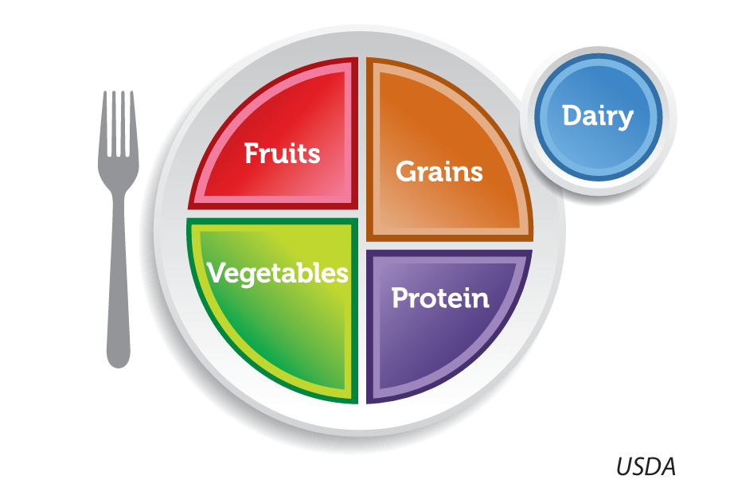
MyPlate Model
USDA

Slide 26
MyPlate
MyPlate is a plate model that outlines amounts to eat from the food groups: grains, dairy, fruits, vegetables and protein.
MyPlate does not show a separate fat group because many fats are found within the foods in the food groups.
MyPlate visually reminds people that there are health benefits from serving yourself portions of fruits and vegetables that make up half your meal.

Slide 27
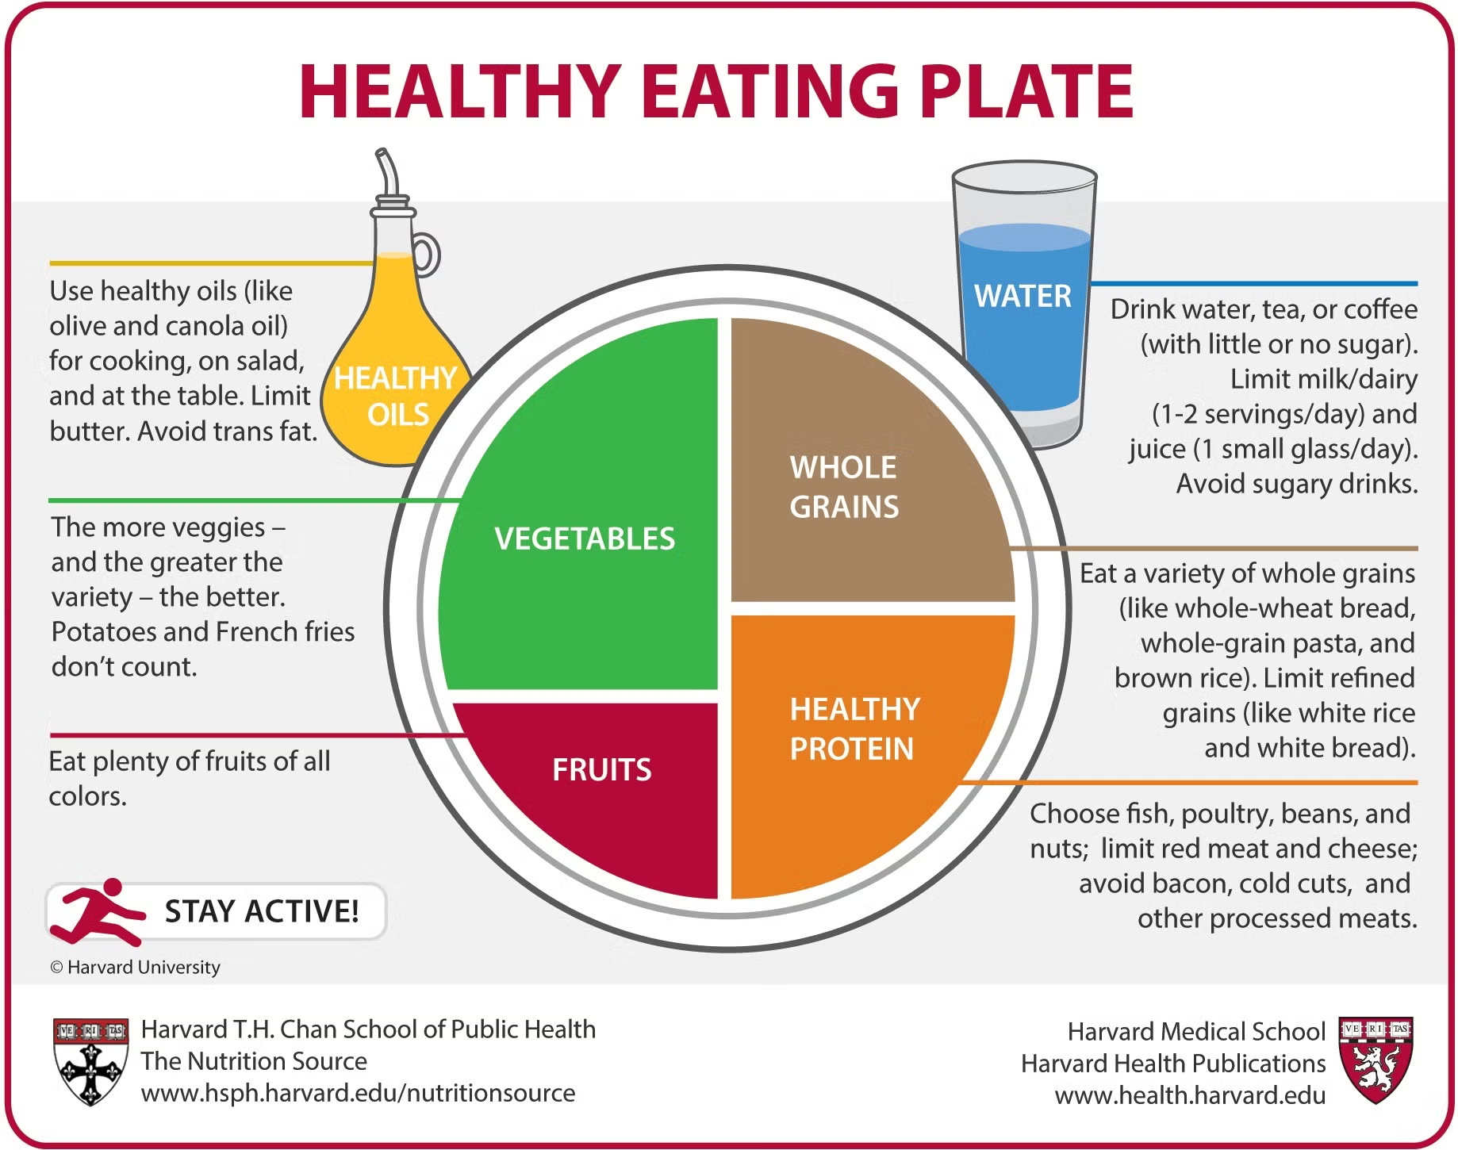
The Harvard Healthy Plate
A similar plate model graphic is the
Healthy Eating Plate created by Harvard
Health Publishing. It is similar to MyPlate
but also shows a glass of water, a reminder
to stay active, and an image of an oil bottle
to represent the benefits of oils for the
human body.
Harvard Health Publishing

Slide 28
Nutrition Guidelines
Another type of dietary planning tool is nutrition recommendations produced by organizations such as The American Heart Association, The American Cancer Society, and the federal government.
Every five years, The United States Departments of Agriculture (USDA) and Health and Human Services (HHS) publish the Dietary Guidelines for Americans. The Dietary Guidelines publication gives recommendations for meal patterns to support health.
The guidelines are used to plan meals for organizations like schools, the military, and programs that serve older adults.

Slide 29

Dietary Guidelines for Americans
Designed to help develop a healthy
dietary pattern or eating pattern. That
is the mix of foods and drinks that make
up a person’s total intake.
General guidelines exist to help choose
a healthy diet.
Other standards (Dietary Reference Intakes,
Percent Daily Value) are available to help
people know how much of each nutrient
they should consume each day.
STEKLO/Shutterstock.com

Slide 30
The 2025–2030 Dietary Guidelines for Americans (1 of 2)
The Dietary Guidelines publication encourages Americans to choose nutrient-dense foods.
In contrast, some foods are called empty-calorie foods. These foods taste good, but they supply fewer nutrients per calorie.
  Most empty-calorie foods contain large amounts of sugar and fat, such as soda, candy, and fried foods. They may also be high in sodium.
  Limiting por­tions of empty-calorie foods can help to reduce added sugars and fats.
  The Dietary Guidelines recommends several key points.

Slide 31
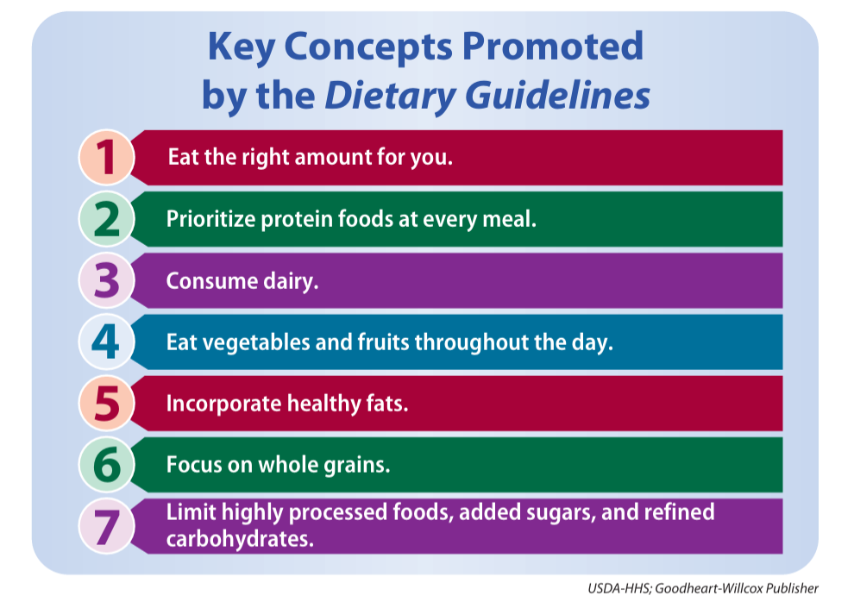
The 2025–2030 Dietary Guidelines for Americans (2 of 2)
USDA-HHS; Goodheart-Willcox Publisher

Slide 32
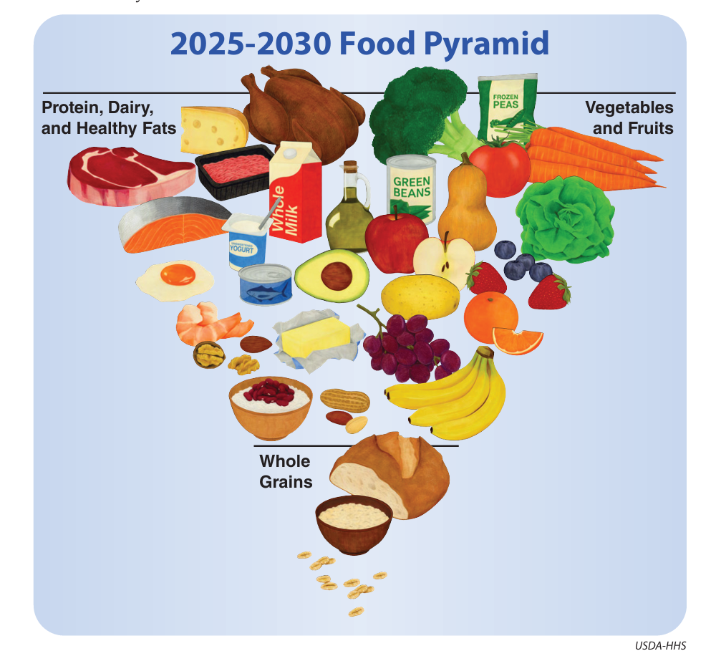
2025–2030 Food Pyramid
A graphic that emphasizes food
options recommended by the
current dietary guidelines replaced
the MyPlate plate model.
USDA-HHS

Slide 33

Planning Healthy Meals and Snacks
Dietary planning tools can be used to plan healthy meals and snacks.
Choosing a variety of nutrient-dense foods from different food groups in the right portions can help you get all the nutrients you need.
Choosing healthy cooking methods and minimizing added sugars, fats, and sodium can help support good health.
Calvin Chan Wai Meng/iStock/Getty Images Plus

Slide 34
Daily Intake and Calorie Needs
Suggested daily intakes from each food group depend on a person’s energy or calorie needs.
Calorie needs are determined by factors such as age, sex, body size, and physical activity level. The number of servings from each food group needed is based on a person's calorie needs.
Activity Level | Females, 14–18 years | Males, 14–18 years
Less Active | 1,800 | 2,000–2,400
Moderately Active | 2,000 | 2,400–2,800
Active | 2,400 | 2,800–3,200
Daily
Calorie
Needs

Slide 35
Calorie Level Patterns for Food Groups
Food Group | Calorie Level Pattern
 | 1,600 | 1,800 | 2,000 | 2,200 | 2,400
Grains* (Whole Grains Recommended) | 5 oz-eq | 6 oz-eq | 6 oz-eq | 7 oz-eq | 8 oz-eq
Vegetables** | 2 c-eq | 2½ c-eq | 2½ c-eq | 3 c-eq | 3 c-eq
Fruits** | 1½ c-eq | 1½ c-eq | 2 c-eq | 2 c-eq | 2 c-eq
Protein Foods* | 5 oz-eq | 5 oz-eq | 5½ oz-eq | 6 oz-eq | 6½ oz-eq
Dairy** | 3 c-eq | 3 c-eq | 3 c-eq | 3 c-eq | 3 c-eq
Fats and Oils | 5 tsp. | 5 tsp. | 6 tsp. | 6 tsp. | 7 tsp.
* Servings in these groups are ounce-equivalents (oz-eq). ** Servings in these groups are in cups.
Goodheart-Willcox Publisher

Slide 36

Food Items to Limit Portions
Added sugars
  Largest source is soda, energy drinks, and sports drinks
  Also jams, jellies, syrups, candy
Saturated fats
  Found in meats and dairy products
  The guideline of limiting saturated fat intake to less than 10% of calories has not changed with the 2025–2030 Dietary Guidelines.
Why is water a good choice for hydration?
A-S-L/iStock/Getty Images

Slide 37
Added Sugars
Foods contain two types of sugars—naturally occurring and added. Naturally occurring sugars are found in many nutritious foods, such as fruit and milk.
Added sugars are ingredients that are put into foods during processing. Diets high in added sugars are linked to various health risks.
Choose water (still or sparkling) and unsweetened beverages to reduce added sugar intake.
The Dietary Guidelines recommends “no amount of added sugars.”
  For adults, a meal should contain no more than 10 grams of added sugars.
  For children under 10, zero added sugar is recommended.

Slide 38
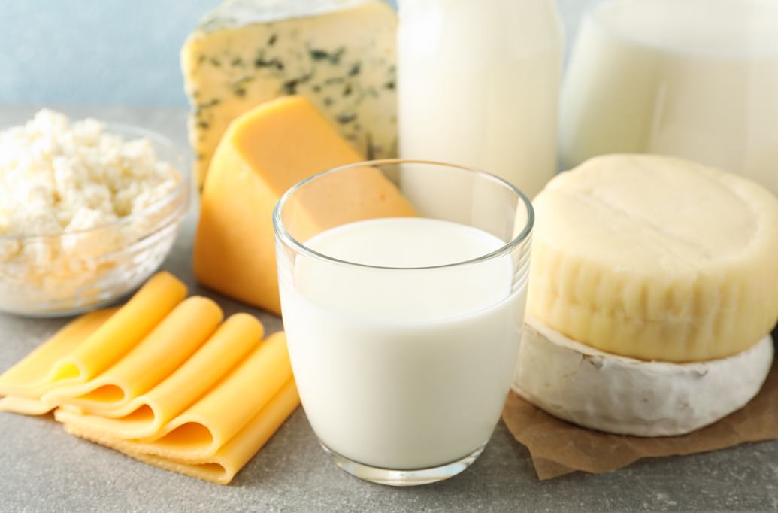
Choosing Dairy Products
Whole milk, 2% milk, 1% milk, and fat-free milk contain the same protein, vitamin D, and calcium content.
When low-fat milk is made from whole milk, the removed fat is used to make butter and cheese.
Cheese is one of the highest sources of saturated fat in the American diet. Balancing portions of cheese, butter, cream cheese, and other high-fat dairy products can help keep saturated fat intake under the recommended target.
Atlas Studio/iStock/Getty Images Plus

Slide 39
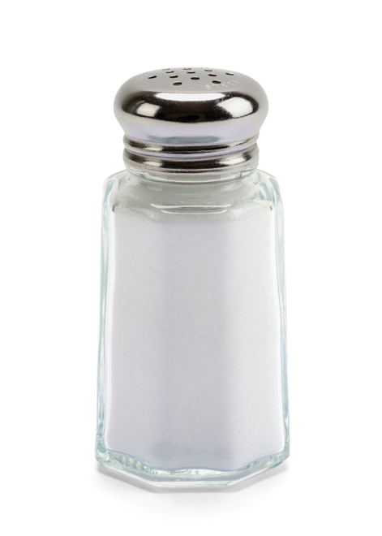
Where Does Sodium Come From?
5% comes from salt added during cooking
6% comes from adding salt to food before eating
11% occurs naturally in foods
77% is added when food is processed by a food company
Advances in Nutrition, Volume 14, Issue 4, July 2023, Pages 592–598
Mega Pixel/Shutterstock.com

Slide 40
Cutting Back on Sodium
  Most sodium in the average diet comes from processed foods. Sodium is a part of salt.
  Top 10 sources are pizza, cold cuts, cured meats, soups, tacos, burritos, breads, rolls, omelets, sauces, condiments, and dressings.
  Too much sodium can raise blood pressure, which contributes to heart disease.
  Shop mindfully.
      Read Nutrition Facts panels.
      Compare products and choose those with lower amounts of sodium.
  Limit salt added to foods during preparation and at the table.

Slide 41
Tips for Healthy Shopping
Choose fresh and minimally processed foods as often as possible.
Select foods high in quality and follow guidelines for storage to maintain their nutrients.
Read product labels and Nutrition Facts labels.
Compare nutrient-dense products.
  Choose products lower in calories, saturated fat, sodium, and sugars.

Slide 42
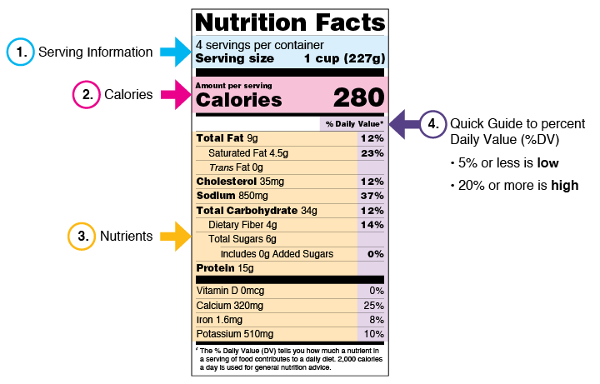
Using the Nutrition Facts Label
FDA.gov

Slide 43
Impact of Food Processing
Currently, there is no definition to describe what is considered a highly processed or ultra-processed food.
Some food processing significantly changes the food from what it originally was (a puffed snack or cracker, protein powder, a protein bar).
Processing does not always decrease nutrient value.
  Fruits frozen without sugar and vegetables canned without salt are nearly as nutrient dense as fresh fruits and vegetables.
  Low-fat milk is processed from whole milk and is more nutrient dense.

Slide 44
Choosing Wisely when Preparing Food
Preparing foods from scratch gives you more control over what goes into them.
  Fats
  Salt
  Sugar
  Seasonings
This can help you prepare foods with maximum flavor and nutrition.

Slide 45
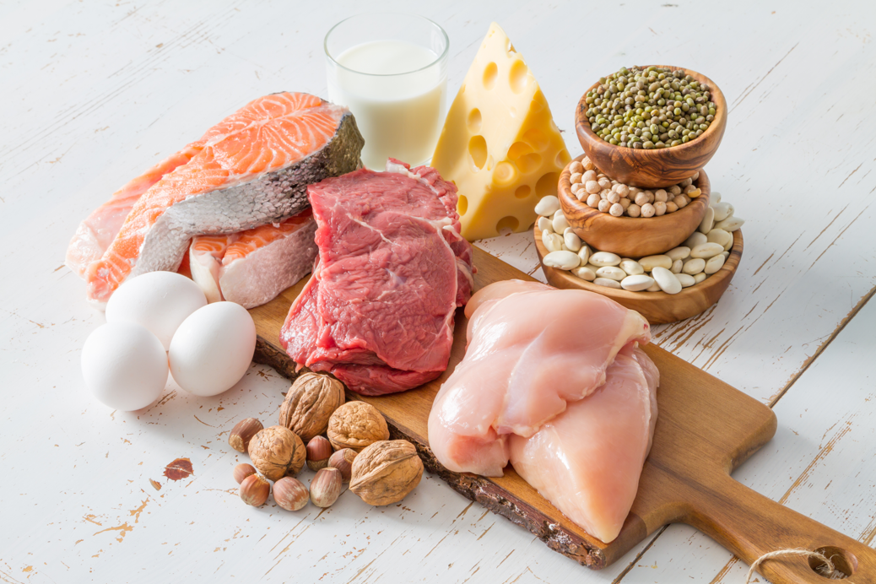
Prioritize Protein
Most main course dishes are planned around a protein.
    In the new Dietary Guidelines, a serving of lean cooked meat, poultry, or fish is 3 ounces.
    A serving of beans is ½ cup.
Choose seafood for a couple of meals each week to increase omega-3 fatty acids.
Keep meats lean to decrease saturated fat intake.
Include plant-based foods like dried beans, peas, and lentils to increase fiber intake. These items are also very affordable.
Oleksandra Naumenko/Shutterstock.com

Slide 46
Add Healthy Side Dishes
Choose sensible portions to help balance calories.
Check serving sizes.
  A small plate or bowl will make modest portions look bigger.
Use items like toppings and spreads, ketchup, soy sauce, sour cream, cream cheese, dressings, and mayonnaise in small portions.
Eat slowly and enjoy the food being eaten. Stop when you feel satisfied but not uncomfortably full.

Slide 47
Snack Sensibly
Portion snacks into dishes rather than eat them out of the package. Avoid mindless eating when not paying attention to the food.
Keep snack foods high in added sugars, fat, and salt out of sight. A candy container that sits on your desk is more tempting than snacks stored in a cupboard.
Keep fresh fruits and vegetables, unsalted nuts and seeds on hand for easy and nutrient-dense snacking.
Think about health along with taste when shopping for healthy snack options.

Slide 48
Summary
Making healthy food and lifestyle choices can improve and promote physical health.
Choose a variety of foods from each food group to get the nutrients that your body needs to stay healthy.
Use dietary planning tools to balance the foods at your meals and throughout the day.
The Dietary Guidelines for Americans is used by professionals to help people follow healthy diet patterns.
Follow smart tips to help you maintain nutrient density of meals and snacks.

