Slide 1
The 2025–2030 Dietary Guidelines for Americans
Educator’s Toolkit

Slide 2
Introduction
This presentation is designed for you, as the instructor, to learn about the changes that have occurred with the release of the 2025–2030 Dietary Guidelines for Americans and help you update your curriculum. Every curriculum will be updated with the changes.
While some of these slides can be used with students if you choose, a separate presentation is available for use with students.
Currently, only limited assets have been made available through the federal government to educate students on the changes. As changes take place, we will continue to make further updates to our products.
Thank you!

Slide 3
What Are Americans Eating?
Research across the US from the NHANES data survey shows that currently:
Intakes are too low for:
Intakes are adequate for:
Vegetables
Fruits
Dairy and fortified soy alternatives
Seafood
Nuts, seeds, and soy products
Whole grains
For individuals ages 1 year and older, vitamin D, calcium, potassium, and dietary fiber are nutrients of public health concern due to underconsumption.
Total grains (including refined grains)
Total protein foods; meat, poultry, and eggs are generally at or above current recommendations.
Sodium, added sugars, and (for ages 2 years and older) saturated fat are nutrients of public health concern due to overconsumption.
Additional nutrients are of public health concern for certain individuals only during specific life stages.

Slide 4
The Dietary Guidelines Process
The 2025–2030 Dietary Guidelines for Americans (DGA) was released by the US Department of Agriculture (USDA) and US Department of Health and Human Services (HHS) in January 2026.
The DGA is updated and published every five years.
The publication provides the foundation for national public health nutrition recommendations.
These guidelines are designed to be used by programs that provide meals to community groups such as schools, the military, and adult meal services such as Meals on Wheels.

Slide 5
Who Creates the DGA?
To prepare for the revision, a committee of selected experts known as the 2025 Advisory Committee reviews available research and creates recommendations called the Scientific Report of the 2025 Dietary Guidelines Advisory Committee
  Before final publication, there is a time for public feedback and comments.
  Recommendations made to HHS and USDA by this group are typically adopted.
The final 2025–2030 DGA was created by a separate appointed committee this time. They created a separate publication titled The Scientific Foundation Report.
  There was no public commentary period for Americans to provide feedback on the recommended guidelines.

Slide 6
Overall Theme of the DGA
Previous Theme (2020): Make Every Bite Count
  Make Every Bite Count guided Americans to focus on nutrient-dense foods within dietary patterns
New 2025 Theme: Eat Real Food
  The overall focus of the revised DGA focuses on consuming whole, minimally processed foods
  Important to note: There is currently no clear definition for what is or is not a “processed food.”
  Braesco et al. EJCN (2022)

Slide 7
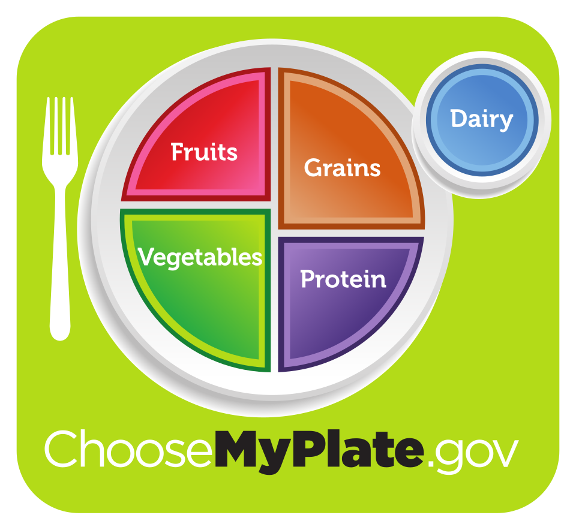
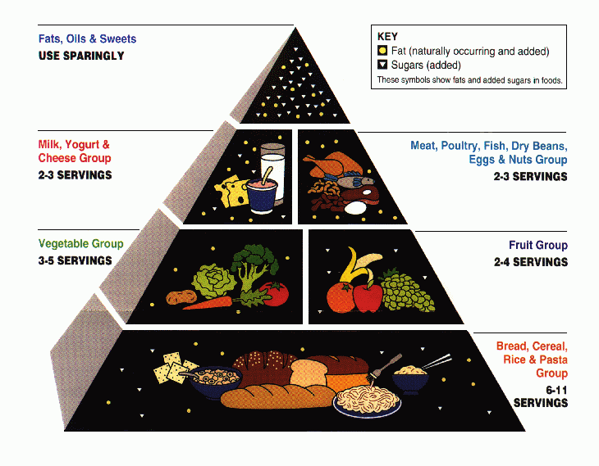
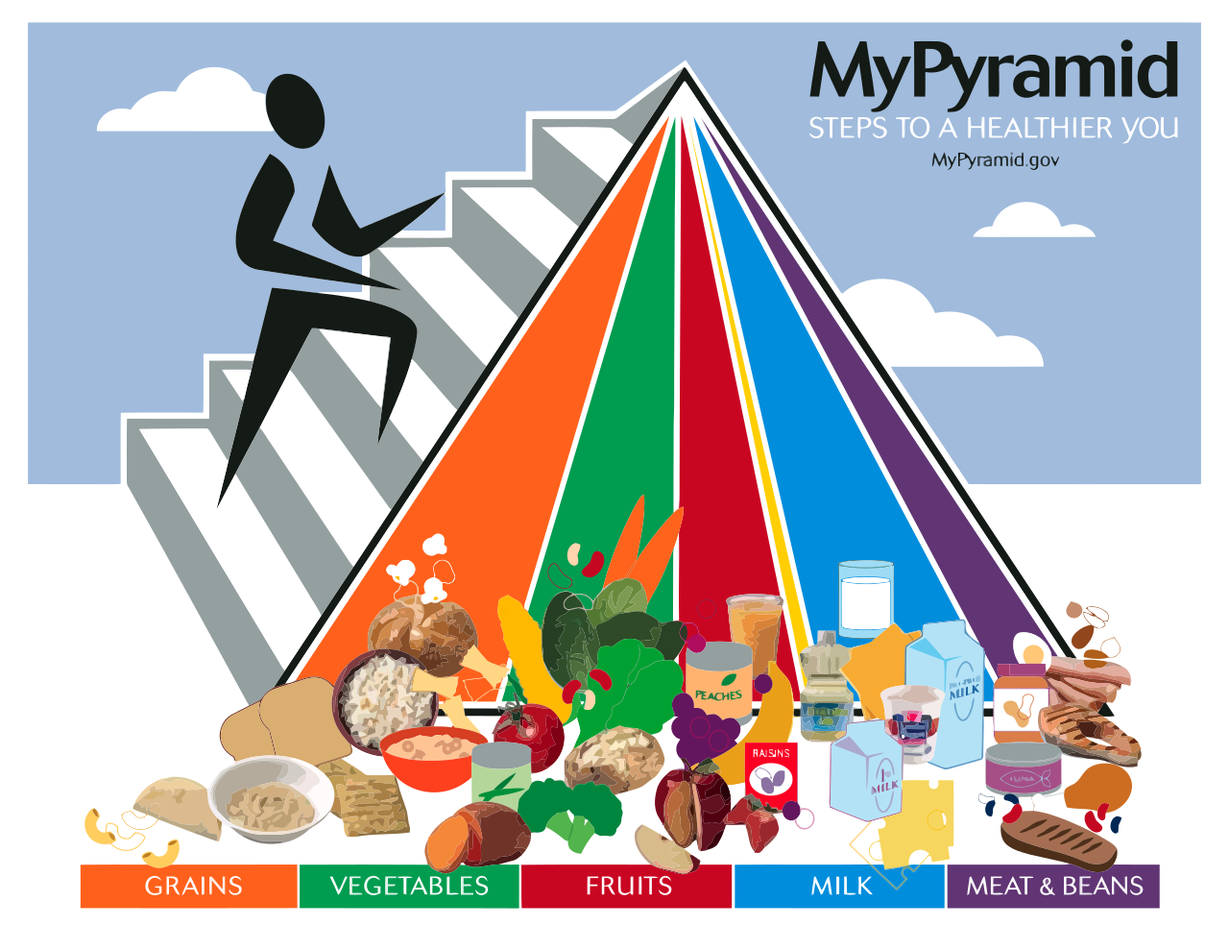
Previous Graphics Used to Visually Show the DGA
In use from 2005 to 2011. Redesigned to show equal importance of food groups and physical activity.
Introduced in 2011 to show balance at each meal to meet overall food group recommendations. Replaced in 2026.
In use from 1992 to 2005. The higher numbers of servings were designed for people who need more calories.

Slide 8
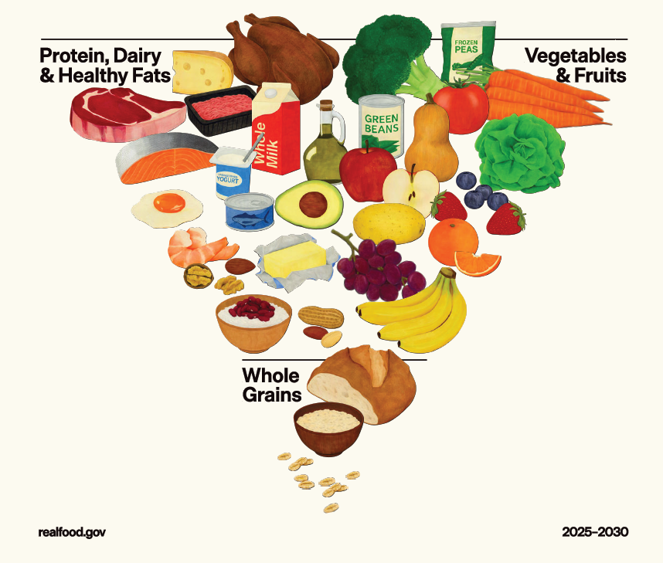
Introduced as part of the 2025–2030 Dietary Guidelines for Americans.

Slide 9
What is a “Real Food”? (1 of 2)
There is no strict definition for what is considered a processed food.
One method used to categorize foods and their processing is a scale called NOVA.
  Most commonly used scale in nutrition research
  Grades food on 1–4 scale from “unprocessed” or “minimally processed” to “ultra-processed”

Slide 10
Which Category of NOVA?
Which category of NOVA do these foods fit into?
Quick reference:
  1 = unprocessed/minimally processed
  2 = processed culinary ingredient
  3 = processed
  4 = ultra-processed
Food name: Potato chips
Ingredients:
Potatoes, vegetable oil, salt
Food name: Hummus
Ingredients:
Chickpeas, water, citric acid, garlic, potassium sorbate (to maintain freshness), red bell pepper
Certain foods such as tofu, fortified plant milks, all breakfast cereals except single-ingredient ones, protein supplements, veggie burgers, guacamole, hummus, and certain whole-grain breads are classified as ultra-processed foods when this system is used.
Notes:
In this example the potato chips would be class 3 and the hummus is class 4, considered an ultra-processed food.

Slide 11
Goals of the 2025–2030 DGA
“The message is simple: eat real food.”
The 2025–2030 DGA states, “American households must prioritize diets built on whole, nutrient-dense foods—protein, dairy, vegetables, fruits, healthy fats, and whole grains.”
“Paired with a dramatic reduction in highly processed foods laden with refined carbohydrates, added sugars, excess sodium, unhealthy fats, and chemical additives, this approach can change the health trajectory for so many Americans.”
“We are putting real food back at the center of the American diet. Real food that nourishes the body. Real food that restores health. Real food that fuels energy and encourages movement and exercise. Real food that builds strength.”

Slide 12
What are the Concerns?
Some experts are concerned that many Americans do not have the resources to prepare or cannot afford to eat a dietary pattern that meets the DGA.
Preparation time
  Processed foods offer convenience for many people. (These include foods like pasta, jarred tomato sauce, luncheon meats, sliced bread, and boxed entrees, which are considered processed foods.)
Access
  Roughly 6% to 13% of people the US have limited access to a grocery store.
  Up to 54 million people live more than 1 mile from a supermarket in urban areas and 10 miles from a store in rural areas.
Storage time
  Canning, freezing, dehydrating, and adding preservatives slows bacterial growth and extends the shelf life of the food.
Cost
  Typically, processed foods are cheaper than many fresh foods due to large-scale production.

Slide 13
Key Points of the Dietary Guidelines
Eat the right amount for you.
Prioritize protein foods at every meal.
Consume dairy.
Eat vegetables and fruits throughout the day.
Incorporate healthy fats.
Focus on whole grains.
Limit highly processed foods, added sugars, and refined carbohydrates.
Notes:
The additional guideline, “Limit Alcoholic Beverages,” has not been emphasized in the general curriculum as it is illegal for most students to intake any alcohol and there is no longer a limit specified. This can be included in your curriculum based on your student needs.

Slide 14
Eat the Right Amount for You
The 2025 DGA encourages, “The calories you need depend on your age, sex, height, weight, and level of physical activity.”
“Pay attention to portion sizes, particularly for foods and beverages higher in calories.”
“Hydration is a key factor in overall health. Choose water (still or sparkling) and unsweetened beverages.”
This is similar to the 2020 DGA, which stated, “Focus on meeting food group needs with nutrient-dense foods and beverages, and stay within calorie limits.”

Slide 15
Prioritize Protein Foods at Every Meal
The 2025 DGA states, “Prioritize high-quality, nutrient-dense protein foods as part of a healthy dietary pattern.”
Previous DGA from past decades matched the Recommended Dietary Allowance of 0.8 grams/kilogram of body weight.
The 2025 DGA increases protein recommendations for the average American to 1.2 – 1.6 grams/kg (an amount typically used for individuals in a medical setting or athletes). Our student population may vary from this general recommendation for adults.
The 2025 DGA presents all sources of protein, animal or plant, as equal. The original committee had recommended prioritizing plant proteins such as dried beans, peas, and legumes based on research that plant proteins help lower risk of cancer and heart disease.
Additionally, the 2025 DGA recommends, “Consume meat with no or limited added sugars, refined carbohydrates or starches, or chemical additives. If preferred, flavor with salt, spices, and herbs.”

Slide 16
What is a “Real Food”? (2 of 2)
NOVA Category | Description | Examples
1: Minimally Processed Foods | Foods from nature with inedible parts removed | Fresh carrots, fresh apples, dried beans or legumes
2: Processed Culinary Ingredients | Category 1 foods in a different form | Olive oil, butter, lard
3: Processed Foods | Made by adding sugar, salt, oil, etc. to group 1 or 2 foods | Smoked meat and fish, freshly made/unpackaged bread
4: Ultra-Processed Foods (UPFs) | Formulation of industrial-use ingredients | Foods that contain high fructose corn syrup, hydrogenated oils, additives

Slide 17
Changes to Protein Portions
Typically, in a list of serving size examples for a food group, all serving suggestions are equal in nutritional value so that one food can be swapped equally for another.
The new DGA has increased the portions of meat and soy products from 1 ounce to 3 ounces. Other portions within the meat group were not changed.
Protein Food | Calories | Protein (grams)
3 oz cooked meat, poultry, seafood | 100–250 | 21
3 oz soy | 120–165 | 14–20
1 egg | 70–80 | 6
½ cup beans, peas, lentils | 110–140 | 7–10
1 oz seeds or nuts | 130–200 | 3–7
2 Tbsp. seed butter or nut butter | 160–220 | 6–8

Slide 18
Consume Dairy
The 2025 DGA recommends, “When consuming dairy, include full-fat dairy with no added sugars. Dairy is an excellent source of protein, healthy fats, vitamins, and minerals.”
Three servings of Dairy are recommended for the average person needing 2,000 calories.
The 2020 DGA recommended Dairy as one of the core elements that make up a healthy dietary pattern.
  “Dairy, including fat-free or low-fat milk, yogurt, and cheese, and/or lactose-free versions and fortified soy beverages and yogurt as alternatives.”

Slide 19
Differences in Cow’s Milk Nutrition
(per 8-ounce Serving)
Type of Milk | Milkfat | Calories | Protein (g) | Total Sugars (g) (lactose) | %DV Saturated Fat | Calcium (mg)
Whole Milk | 3.25% | 149 | 8 | 12 | 25% | 306
Reduced-Fat Milk | 2% | 122 | 8 | 12 | 15% | 309
Low-Fat Milk | 1% | 106 | 8 | 12 | 8% | 310
Fat-Free Milk (skim milk, nonfat milk) | <1% | 84 | 8 | 12 | 0% | 325
Source: USDA FoodData Central

Slide 20
Saturated Fat Guidance
Although the 2025 DGA encourages food sources of saturated fat such as whole milk, butter, and beef tallow, the overall percentage of calories recommended from saturated fat remains at 10%, the same guideline as the 2020 DGA.
To keep overall saturated fat intake under the limit, it would be necessary to balance saturated fat intake among selected food items.
The highest source of saturated fat for Americans include burgers (meat, cheese, bacon), cheese, pizza, ice cream, cakes, high-fat cuts of meat, and full-fat dairy.

Slide 21
Eat Vegetables and Fruits Throughout the Day
Vegetables and fruits serving goals for a 2,000-calorie dietary pattern, adjusting as needed based on your individual caloric requirements:
  Vegetables: 3 “servings” per day
  Fruits: 2 “servings” per day
Like the other food groups, the general word servings is used rather than ½ cups and cups that were used starting with the 2010 DGA.
The vegetable subgroups and guidelines for intake for the subgroups (dark-green, red and orange, starchy, and other vegetables) have been eliminated.
  Previously, guidelines were given for a set number per week.

Slide 22
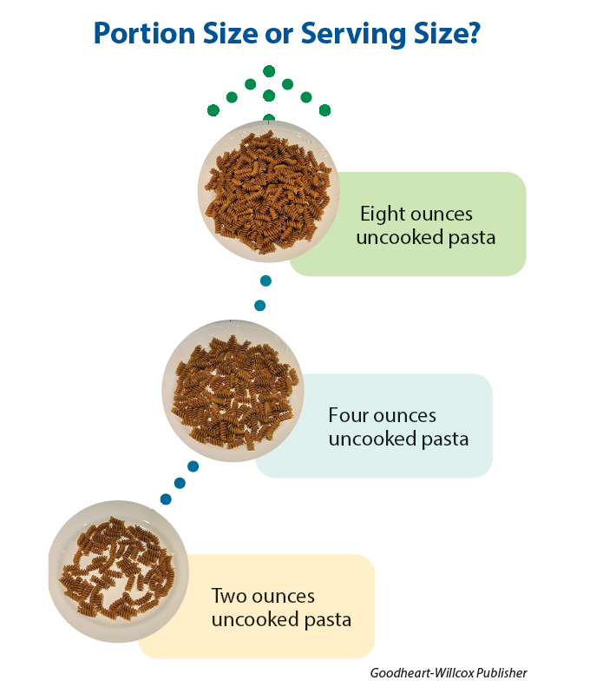
Changes from Portions to Servings
A portion is the amount that you serve yourself at one time.
A serving is a standard amount that appears in examples from each food group or Nutrition Facts label. (Labels may reflect common portions people eat.)
Under the MyPlate system, actual household measurements were used to represent servings in the food group such as tablespoons, ½ cups, and cups, along with ounces for grains and meat.
In the 2025–2030 DGA, the amounts have returned to servings. A person must know how many servings are recommended and then what an example of the serving size is.
Goodheart-Willcox Publisher

Slide 23
Incorporate Healthy Fats
A new food group has been added that is called Healthy Fats.
Previously in the MyPlate, there was no specific food group called Fats. In most eating patterns, the main sources of fat are found in the foods within the other food groups.
“When cooking with or adding fats to meals, prioritize oils with essential fatty acids, such as olive oil. Other options can include butter or beef tallow.”
  While olive oil is beneficial to the human body, it does not contain high amounts of essential fatty acids.
  Linoleic acid (omega-6) makes up 4% to 21% of the fats.
  There are only trace amounts of alpha-linoleic acid (omega-3).
  The main fat is oleic acid (omega-9). This can be made by the body, so it is not an essential fatty acid.
The acceptable macronutrient distribution range (AMDR) of less than 30% of calories from fat has been removed.

Slide 24
More About Oils
The DGA section “Healthy Fats” states, “More high-quality research is needed to determine which types of dietary fats best support long-term health.”
Nutrition research often relies on observational studies that last over years and decades. Experts have commented that many observational studies were excluded in the data used to develop the final guidelines, but the studies were included in the original Scientific Report.
While the term seed oils is popular on social media, it is not a term used by food scientists because of its inaccuracy.
Research supports improvements in cardiovascular risk factors when plant-based oils are used instead of butter.
We know that Americans do not consume enough omega-3 fats, and too much omega-6, mainly from processed foods, but it’s not necessary to avoid all the common sources of omega-6 from plant-based oils.
Notes:
The Academy of Nutrition & Dietetics has resources as part of their Nutrition Fact Check on Seed Oils at https://www.eatrightpro.org/nutritionfactcheck#seed

Slide 25
Focus on Whole Grains
In previous DGA publications, whole grains were prioritized, but refined grains were also recognized as a beneficial part of the diet.
The previous guideline recommended that Americans consume half of their grains as whole grains. This allowed consideration of white rice and other cultural staple foods such as tortillas.
For the 2025–2030 DGA, the food group has been changed to “Whole Grains” rather than “Grains.” All the examples of potential choices from this group are whole grains. White rice, most cereals, most commercial breads, flour tortillas, and crackers are not “allowed.”

Slide 26
Enriched and Fortified Grains
In the US, all refined grains must be enriched with B vitamins and iron to replace what was lost in food processing.
All refined grains in the US must be fortified with folic acid to lower the risk of folate deficiency. This intervention in the US has improved the rate of neural tube defects.
As part of the original Scientific Report, extensive food modeling was done that showed that including enriched grains and fortified grains in the category of “refined grains” is necessary to meet B vitamins, iron, and folate needs because people do not consume enough of the foods that are naturally high in folate, such as beans and green leafy vegetables.

Slide 27
Other Grains Group Changes
In addition to eliminating refined grains, the portions of grains has been decreased to 2–4 servings per day depending on calorie needs.
Previous DGA recommended 6 servings per day.
What is an example of a grain serving?
  ½ cup of oatmeal
  ½ cup of rice, pasta, or cooked cereal
  1 ounce of ready-to-eat cereal (about 1 cup for most cereals)
  1 slice of bread
For active individuals without diabetes, 6 servings spread across meals equals 1 cup of most grains, 3 times per day.

Slide 28
Limit Highly Processed Foods, Added Sugars, and Refined Carbohydrates
As mentioned previously, there is no definition for what is a highly processed food.
The DGA recommends, “Avoid highly processed packaged, prepared, ready-to-eat, or other foods that are salty or sweet, such as chips, cookies, and candy that have added sugars and sodium (salt). Instead, prioritize nutrient-dense foods and home-prepared meals. When dining out, choose nutrient-dense options.”

Slide 29
Added Sugars
Previously, the added sugar guideline was 10% of calorie intake.
This has been changed to 10 grams per meal for adults and zero added sugar for all children under the age of 10.
The guidelines state, “No amount of added sugars or non-nutritive sweeteners is recommended or considered part of a healthy or nutritious diet.”
Avoid sugar-sweetened beverages, such as sodas, fruit drinks, and energy drinks.
There are concerns that the guideline for zero added sugar for children under 10 sets up unrealistic expectations to exclude all foods that are eaten for celebrations and holidays, such as birthday cake.

Slide 30
Infants, Toddlers, and Children
Food introduction guidelines remain the same as previously.
“Avoid added sugars during infancy and early childhood.”
A new recommendation states that for ages 5–10 years, “No amount of added sugars is recommended.”
A new guideline added, “Full-fat dairy products are important for children to help meet energy needs and support brain development.”
The Whole Milk for Healthy Kids Act passed in 2026 allows for whole milk to be served in schools and not counted towards the 10% of calories from saturated fat limit that schools must stay under.

Slide 31
Portions for Age Groups
School lunch guidelines are based on the DGA. Current guidelines that comply with the 2020–2025 DGA were just published in 2024.
It may take time until guidelines for the Child and Adult Care Food Program (CACFP) catch up with the 2025–2030 DGA.
There are concerns that active children and teenagers will not be able to meet their calorie needs with limited grain servings.
School lunch programs will need increased funding for upgrades to kitchen equipment to prepare meals without processed foods and increased protein portions.

Slide 32
Chronic Disease
Previously, the DGA were designed to support healthy individuals.
The 2025–2030 DGA states that one of its goals is to “help prevent the onset or slow the rate of progression of chronic disease, especially cardiovascular disease, obesity, and type 2 diabetes.”
Suggestions include:
  “a lower carbohydrate diet”
  A sodium intake of 2,300 milligrams or less
  A saturated fat intake of less than 10% of total calories (unchanged from the last DGA).

