Slide 1

A Visual History of Nutrition Guidelines in the US
Accompanies DGA Handout 1
Presentations for PowerPoint
All images via USDA in the public domain

Slide 2
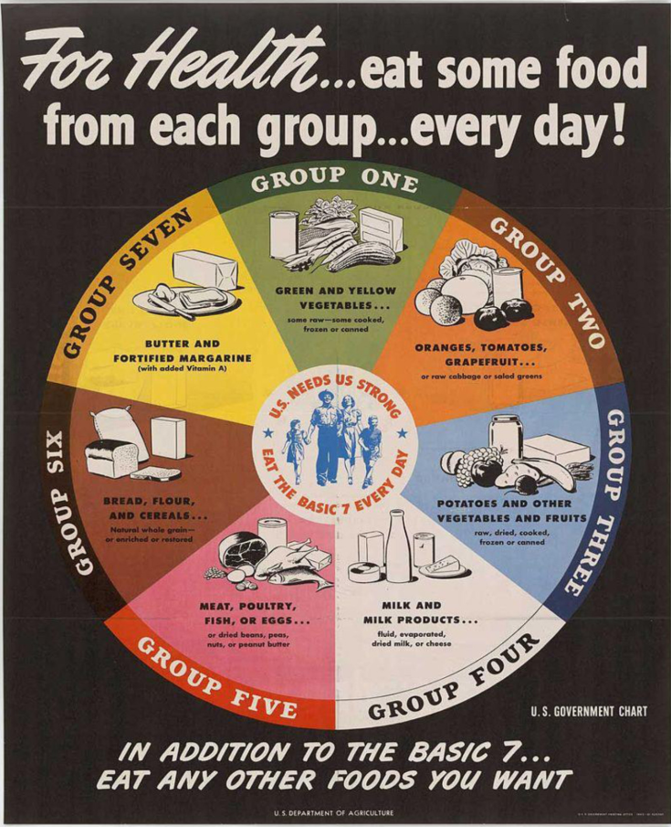
1940s

Slide 3
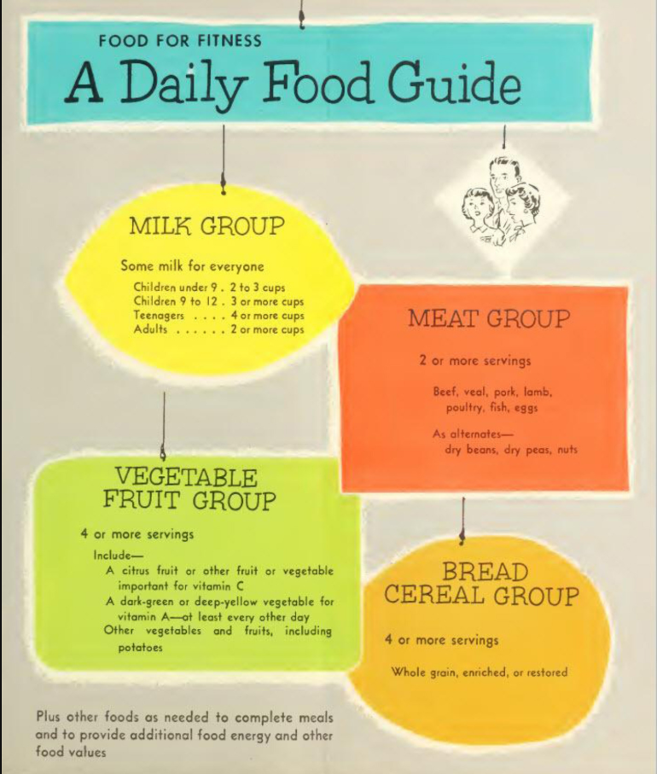
1950

Slide 4
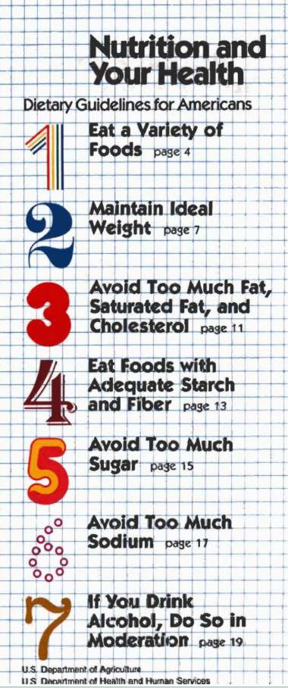
1980s

Slide 5
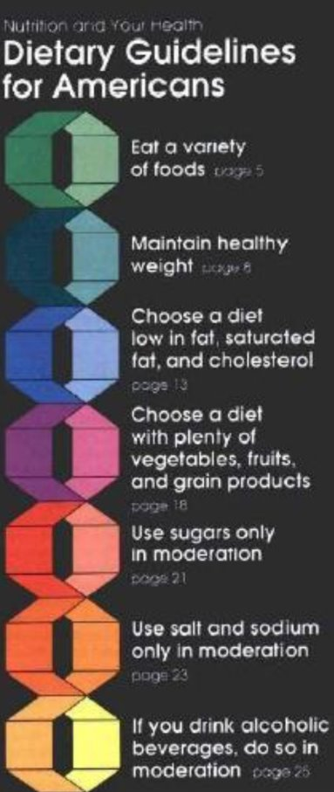
1990
Notes:
Developed to show the 1990 guidelines as a graphic. The range of servings showed that smaller or less active people needed less servings from each group. Fat’s, Oils, and Sweets make up the smallest recommended servings if desired by a person, but not necessary.

Slide 6
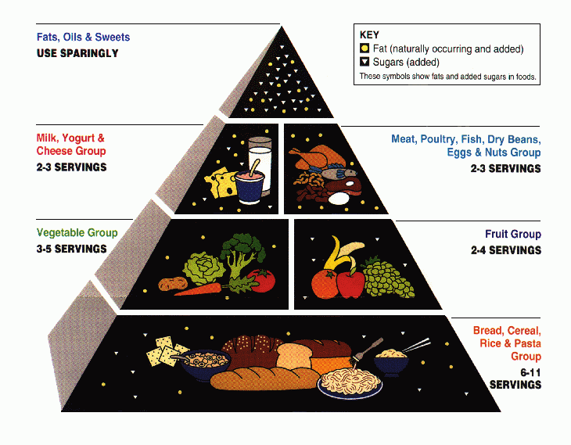
1992
Notes:
Developed to show the 1990 guidelines as a graphic. The range of servings showed that smaller or less active people needed less servings from each group. Fat’s, Oils, and Sweets make up the smallest recommended servings if desired by a person, but not necessary.

Slide 7
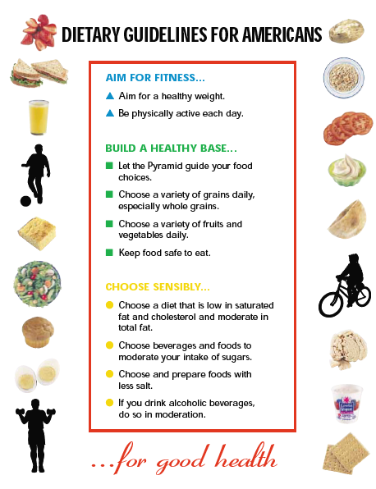
2000 DGA

Slide 8
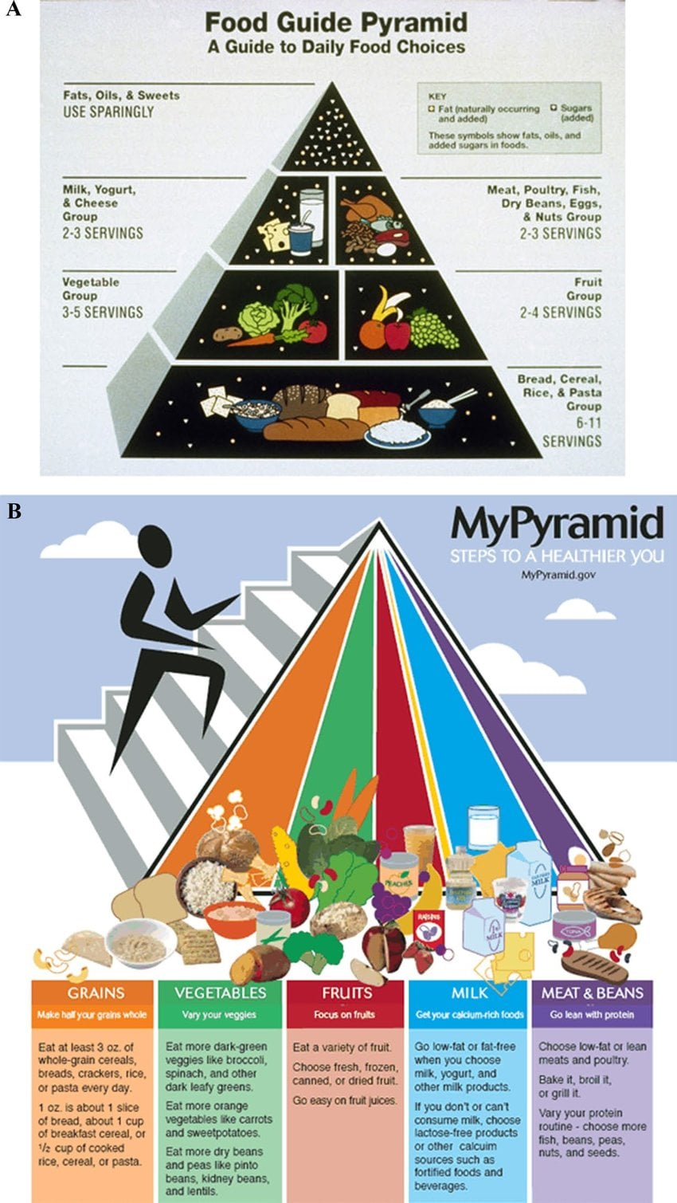
2005
Notes:
Adjust to show that all food groups are important, as is physical activity. The yellow line represented Oils.

Slide 9
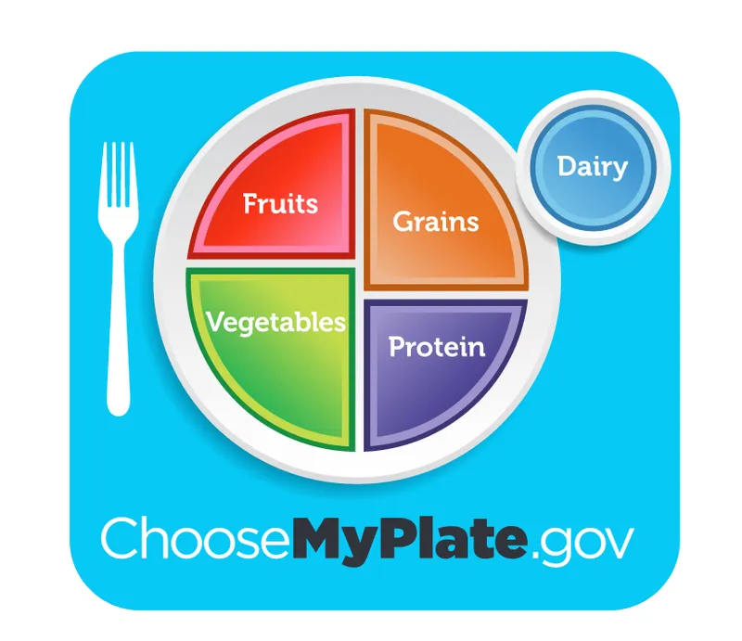
2011
Notes:
This version of the guidelines introduced the concept of healthy eating patterns, and in 2011 was represented by the MyPlate icon

Slide 10

2020–2025
Notes:
MyPlate was maintained as the graphic from 2011 until 2025.

Slide 11
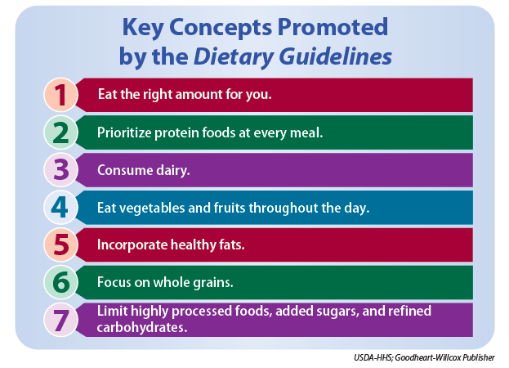
2025–2030

Slide 12
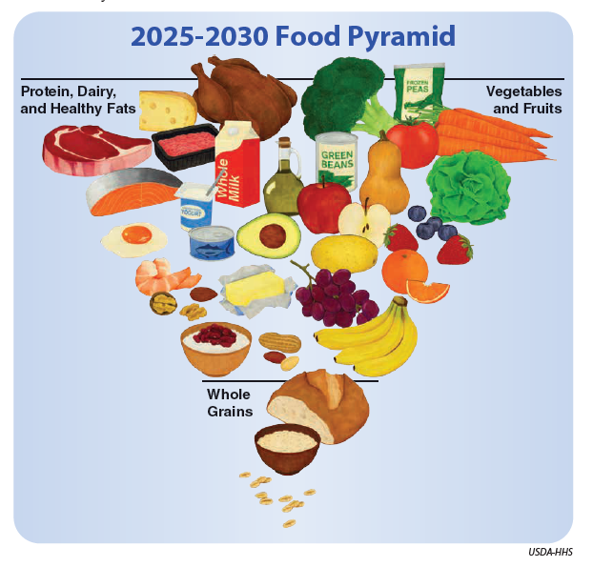
2025

